Slide 1

WAY TO ENTERPRISE
React JS
VTI ACADEMY
Author: duy.nguyenngoc1@vti.com.vn
March 2020

Slide 2
Agenda
HelloWorld program
ReactJS
JSX
Class & Functional Component
State & Props
Create app through npm command line
Assignments
Copyright © VTI Academy All Rights Reserved

Slide 3
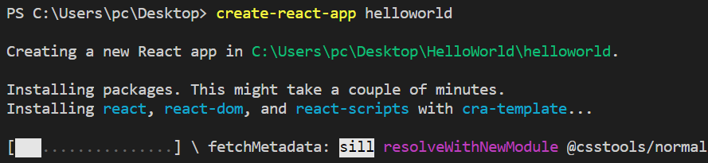
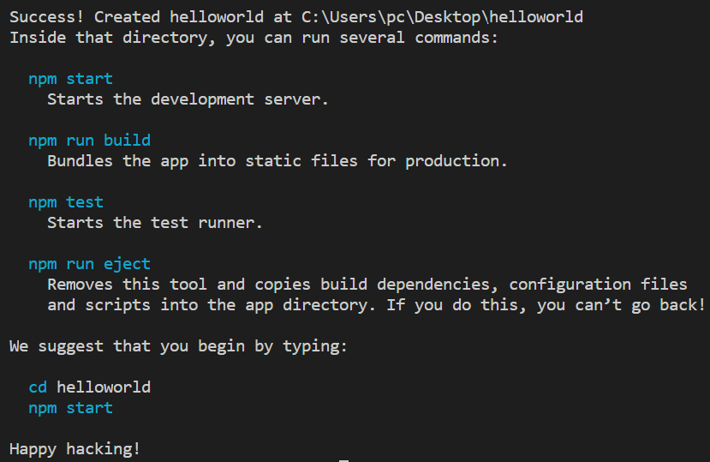
HelloWorld program
Step 1: Install React
npm install -g create-react-app
Step 2: Create a new React project
create-react-app helloworld

Slide 4
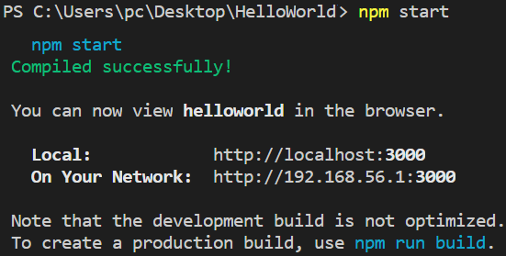
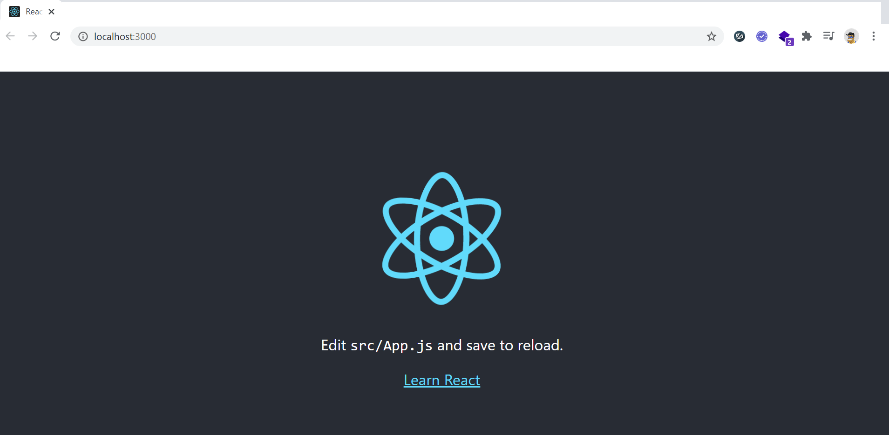
HelloWorld program
Step 3: Run project
npm start
Browser

Slide 5
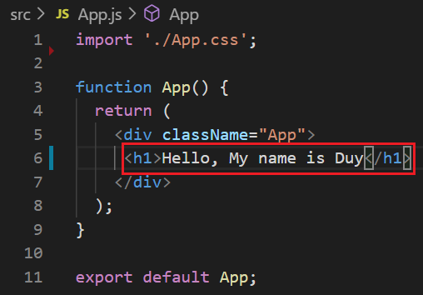
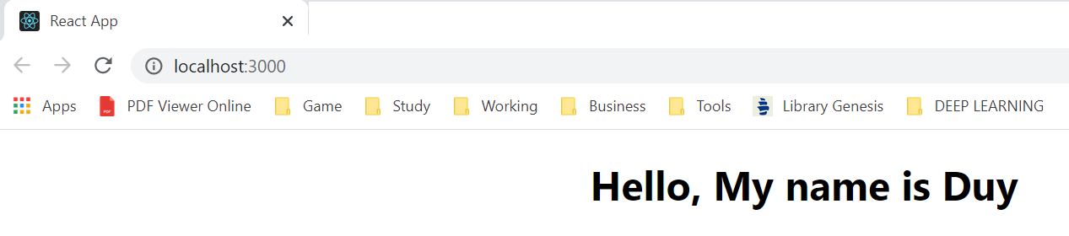
HelloWorld program
Step 4: Edit code
Browers

Slide 6
Testing System Assignment
Self-practice

Slide 7



ReactJS
A JavaScript library for building reusable UI components
Created by Facebook in 2011, released 2013
Auto compile code & Refresh Screen
ReacteJS (for Web) & React Native (for mobile)
Application : WhatsApp, Instagram, Facebook

Slide 8
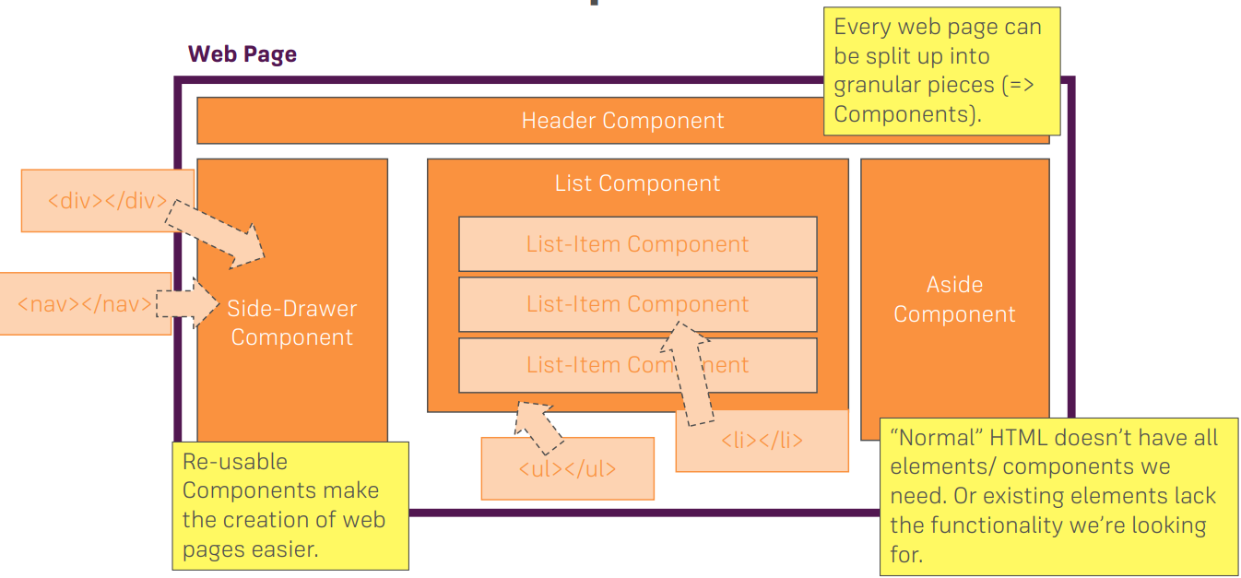
ReactJS
Built around the component

Slide 9
React Running Tools
Visual Studio Code
https://codepen.io/pen
https://codesandbox.io/s/new

Slide 10

Feature

Slide 11
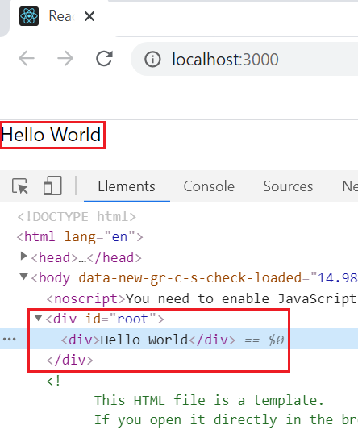
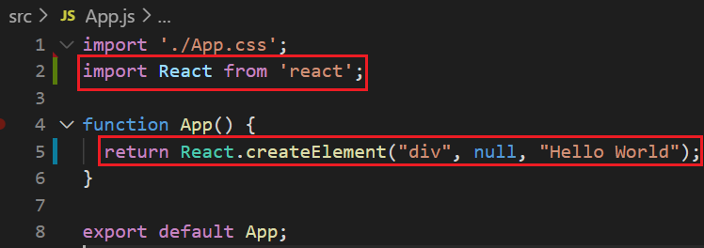
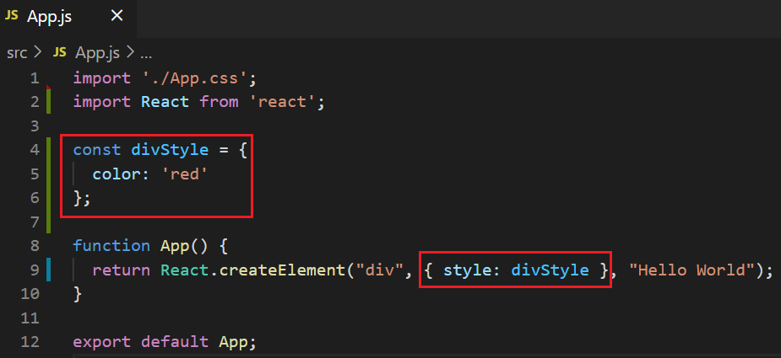
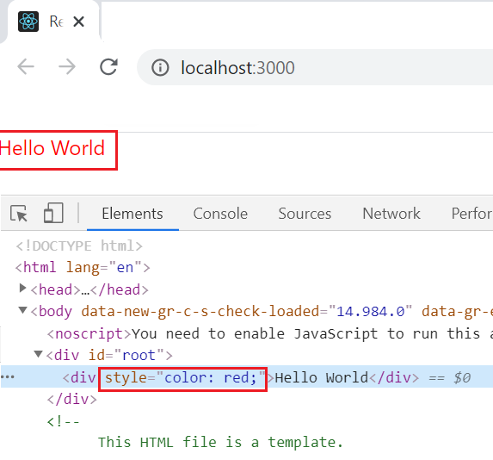
Non JSX
React.createElement(component, props, ...children)

Slide 12
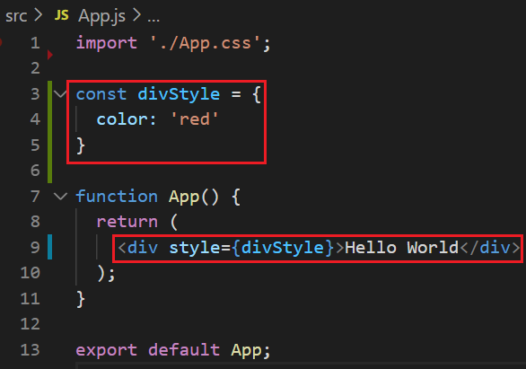
JSX
Stands for JavaScript Extension
JSX has a syntax similar to HTML
JSX is in the sign {}

Slide 13
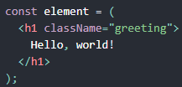
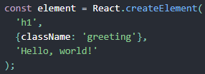
Non JSX & JSX
Babel will compile JSX to React.createElement
https://babeljs.io/repl/#?presets=react&code_lz=GYVwdgxgLglg9mABACwKYBt1wBQEpEDeAUIogE6pQhlIA8AJjAG4B8AEhlogO5xnr0AhLQD0jVgG4iAXyJA

Slide 14
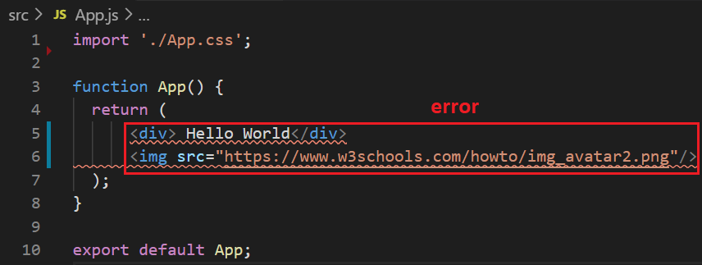
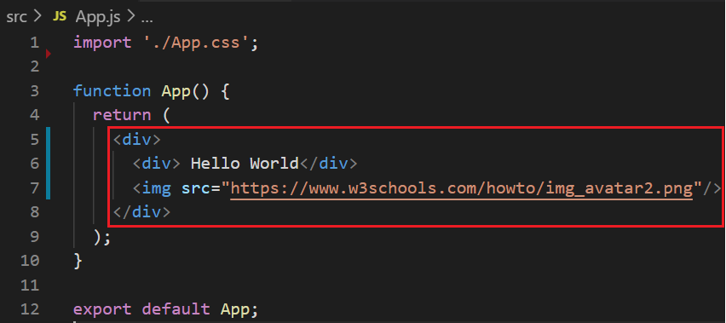
JSX’s Syntax
only 1 parent tag

Slide 15
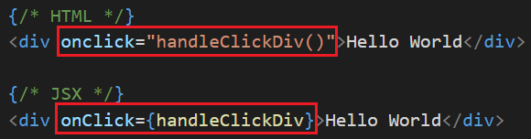
HTML, Javascript & JSX Comparing
Syntax
The properties and methods are both camelCase

Slide 16
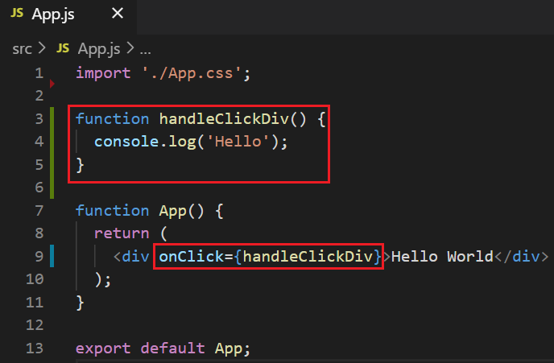
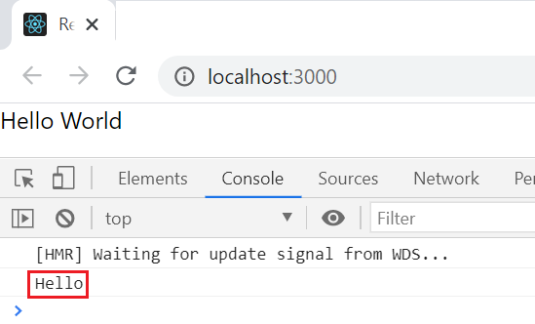
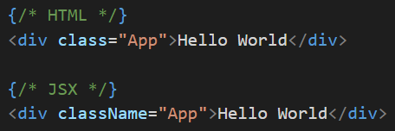
HTML, Javascript & JSX Comparing
Example

Slide 17
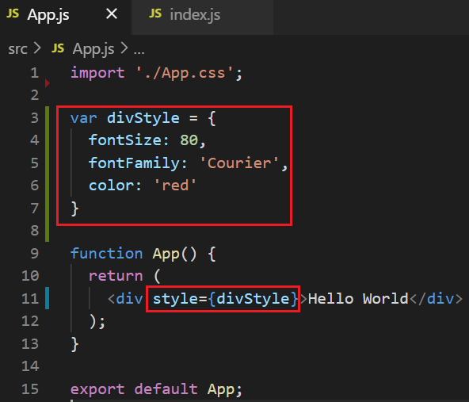
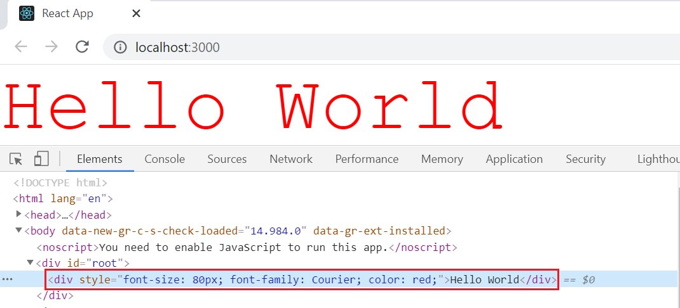
HTML, Javascript & JSX Comparing
Style
Way 1
Way 2
Stylesheet
Auto apply px
Inline Style

Slide 18
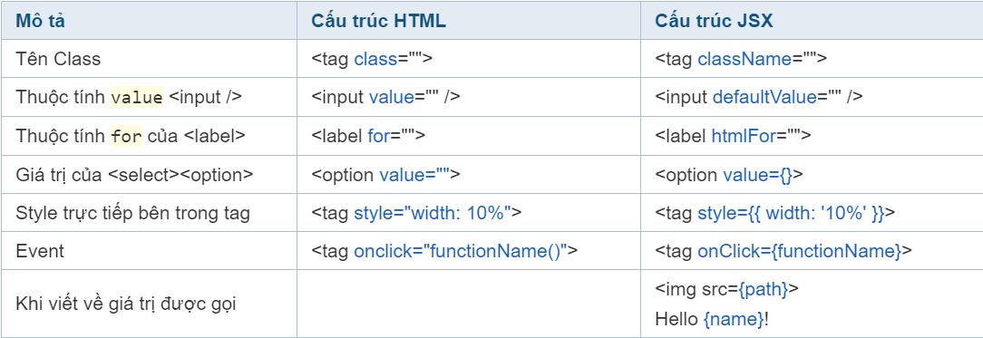
HTML, Javascript & JSX Comparing
https://reactjs.org/docs/dom-elements.html

Slide 19
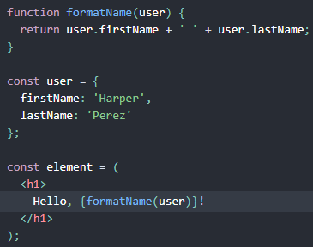
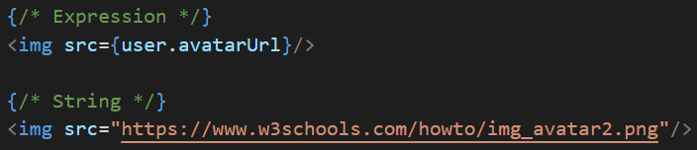
JSX’s Syntax
Value can use string or expression

Slide 20
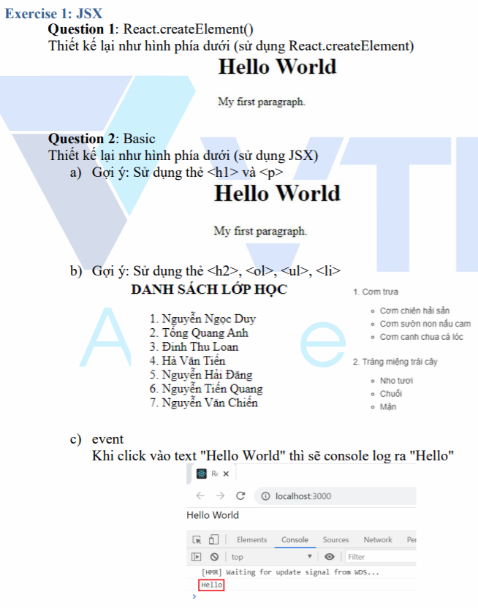
Testing System Assignment
Exercise 1: JSX

Slide 21
Component
Class Component & Functional Component
Props & State
Composition & Inheritance

Slide 22
Component
Everything in react is written as a component
Reusable components
Split logic

Slide 23
Component
2 types
Class component
Functional component

Slide 24
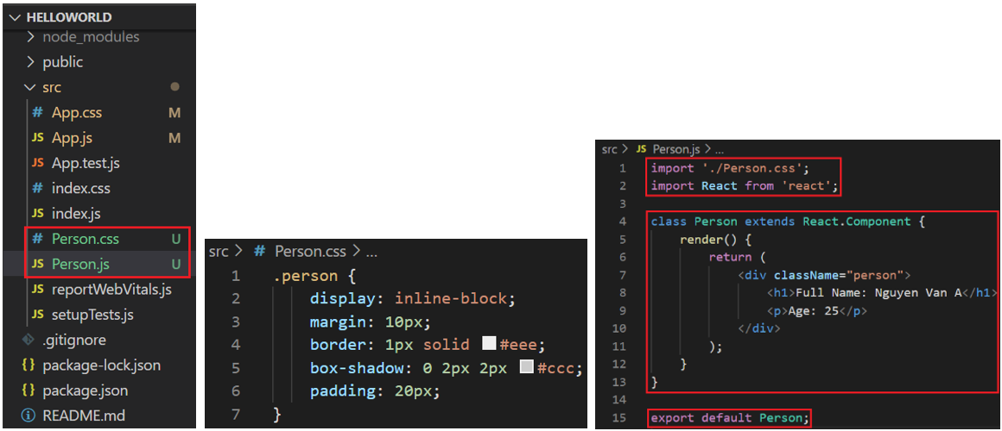
Class Component
Example 1:

Slide 25
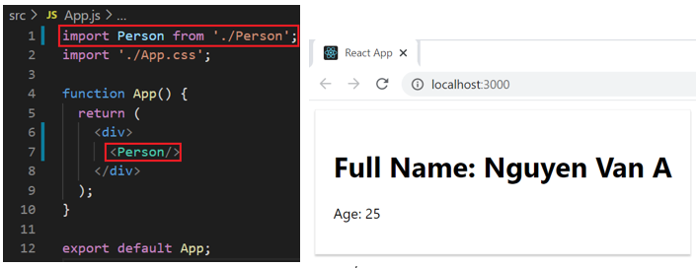
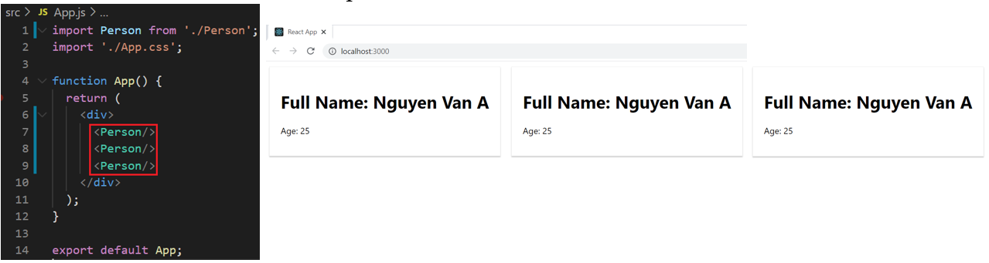
Class Component
https://codepen.io/anon/pen/MELQaQ

Slide 26
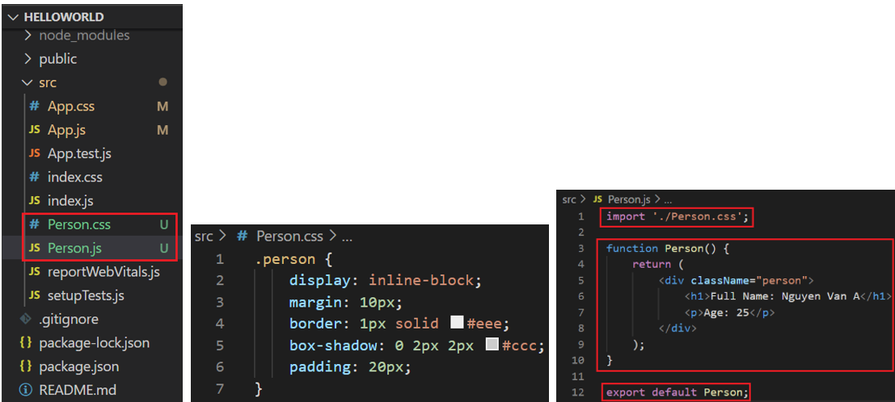
Functional Component
Example 2:

Slide 27
Functional Component
https://codepen.io/anon/pen/MELQaQ

Slide 28
Testing System Assignment
Self-practice

Slide 29
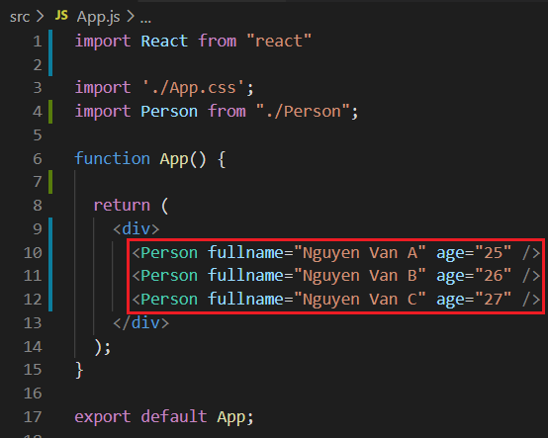
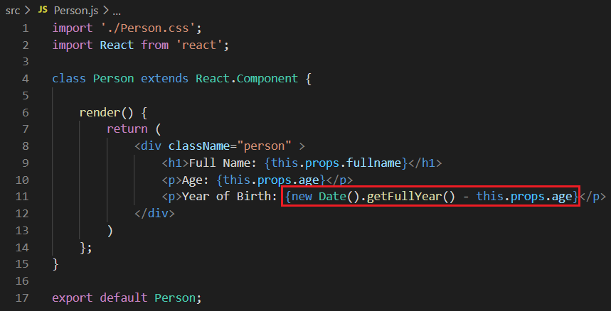
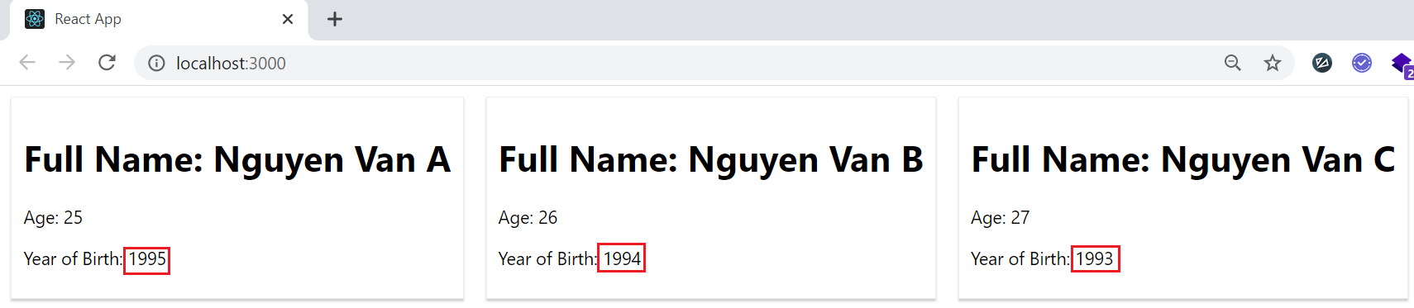
Example
Example 3: class component
Send data to component

Slide 30
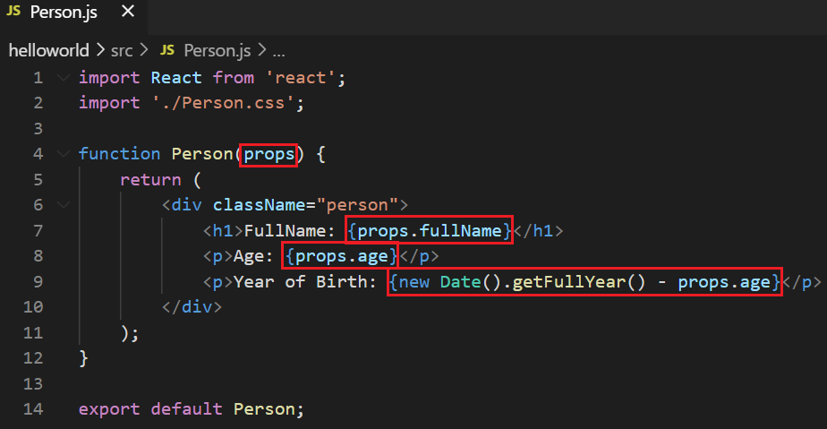
Example
Example 4: functional component

Slide 31
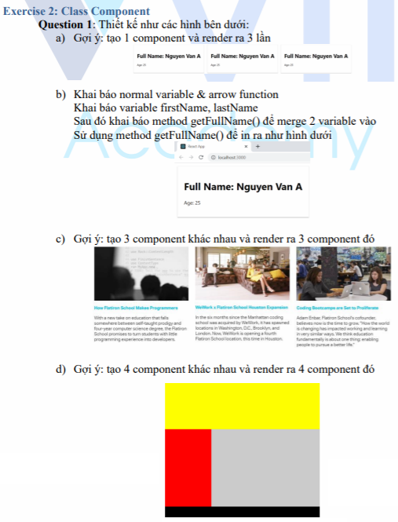
Testing System Assignment
Exercise 2: Class Component & Exercise 3: Functional Component

Slide 32
Component understanding
The logic in {} can be implemented

Slide 33
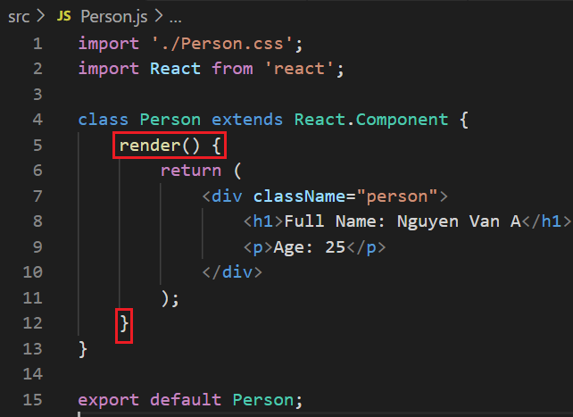
Component understanding
render() method: render JSX to ReactDOM

Slide 34
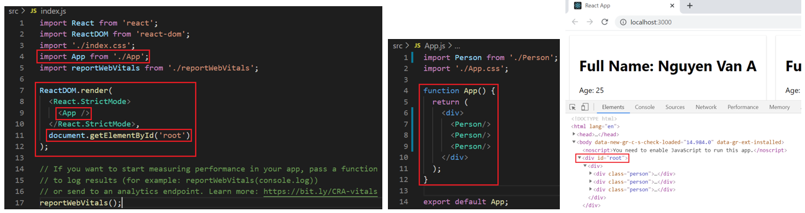
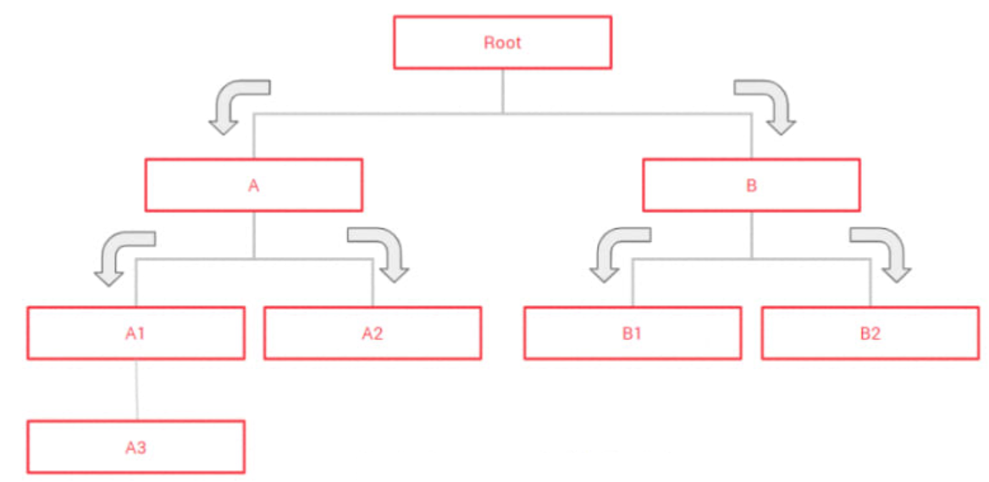
Component understanding
App Component (root component)
Component Tree

Slide 35
Normal Variable & Arrow function
Class component
Always use this keyword when calling variable, function
Declare the variable in the constructor
Function component
DO NOT use this keyword when calling variable, function
Declare the variable, function with let/const keyword

Slide 36
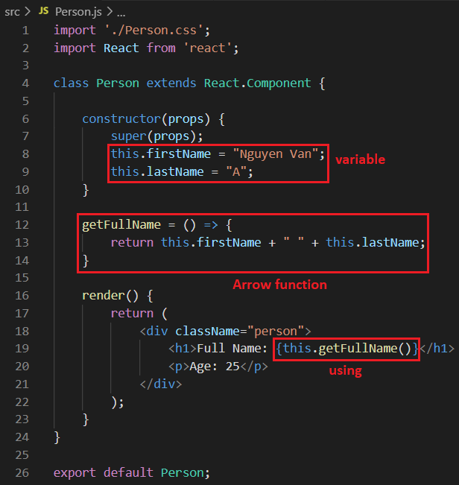
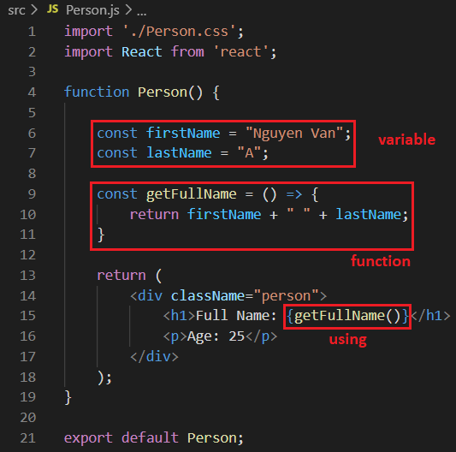
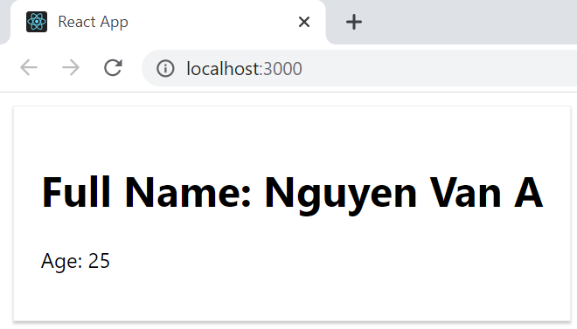
Normal Variable & Arrow function
Class component
Functional component

Slide 37
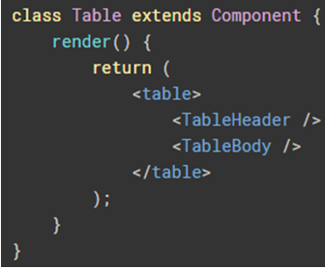
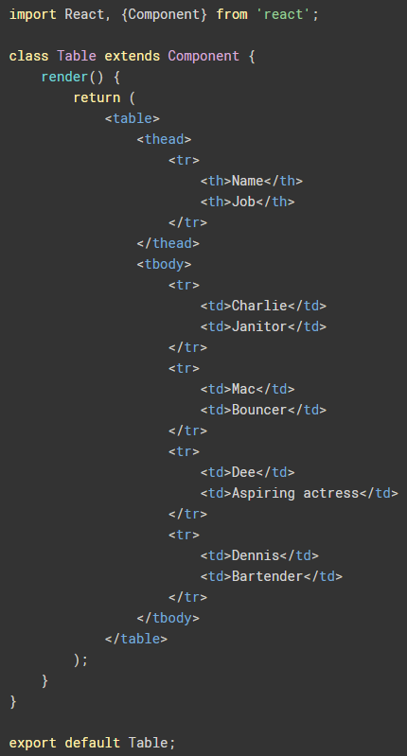
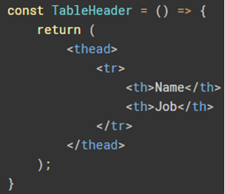
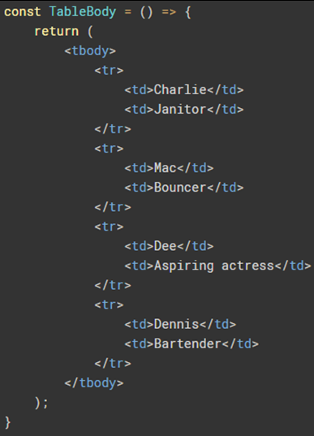
Best Practices
Divided into smaller components

Slide 38
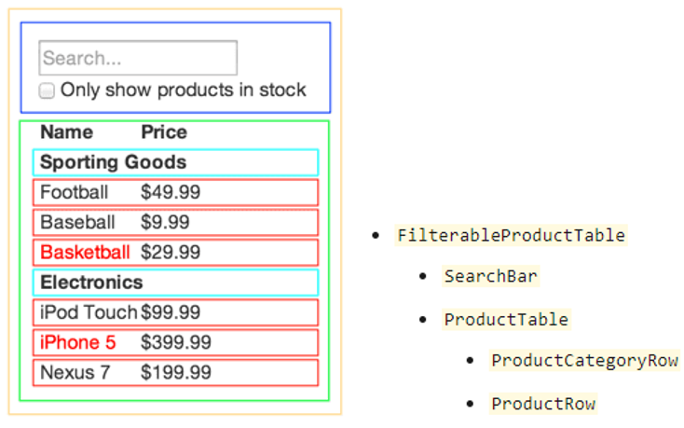
Best Practices
https://codepen.io/gaearon/pen/BwWzwm?editors=0010

Slide 39
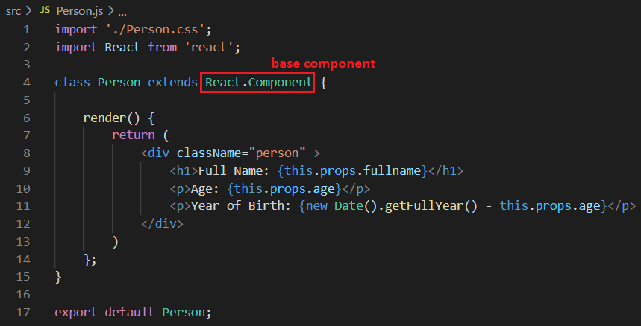
Best Practices
DO NOT create base component

Slide 40
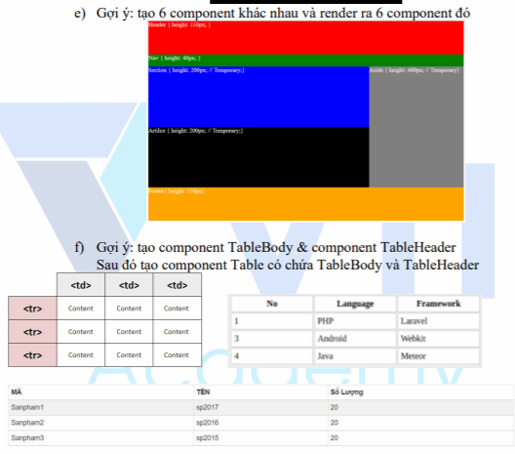
Testing System Assignment
Exercise 2: Class Component e, f

Slide 41
Props
Stand for Properties
Similar to HTML’s attribute, parameter of function
Read-only, immutable
Send data between parent component and child component
Type
{variable}
{expression JavaScript}
{props.children}

Slide 42
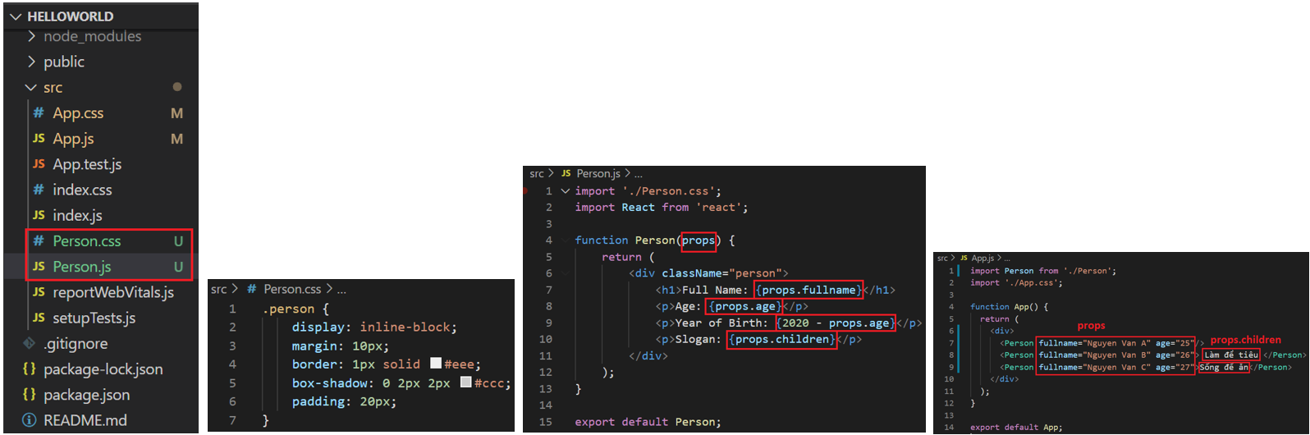
Props
Functional component
Example 1:

Slide 43
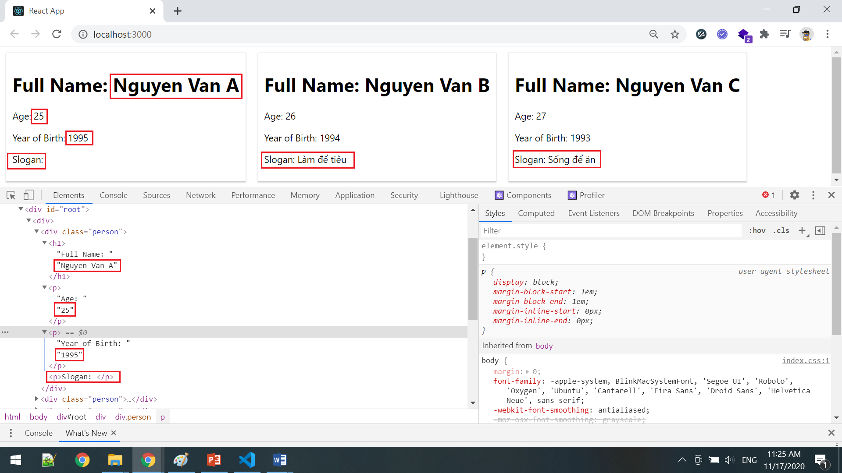
Props

Slide 44

Props
Class component
Example 2:

Slide 45
Testing System Assignment
Self-practice

Slide 46




Props
Example 3:

Slide 47

Props
Example 4: Pass component to component
https://codepen.io/gaearon/pen/gwZOJp?editors=0010

Slide 48

Props
Example 5: defaultProps (Functional component)

Slide 49

Props

Slide 50

Props
VD6: defaultProps (Class component)

Slide 51
Testing System Assignment
Self-practice

Slide 52
State
Save data, information in component & auto re-render when changing data
Only using in Class Component
Scope: only a Component

Slide 53

State
Example 1:

Slide 54

State
https://facebook.github.io/react-native/docs/state
https://www.javatpoint.com/react-state

Slide 55
Testing System Assignment
Self-practice

Slide 56

State
Get old state before update new state
Example: https://codepen.io/gaearon/pen/xEmzGg?editors=0010

Slide 57

Best Practices
Should initialize state in constructor

Slide 58

Best Practices
Do not modify State directly (React will not re-render the component)

Slide 59
Best Practices
Keep the state as simple as possible

Slide 60

State & Props

Slide 61


State & Props
Parent component: set State
Child component: set Props
Example 2:

Slide 62

State & Props
handle state we should use redux

Slide 63
Testing System Assignment
Self-practice

Slide 64
Composition & Inheritance
React recommends using Composition over Inheritance for code reuse between components
React is designed oriented "Component" programming, React will split the application into many Components (unlike Java which is by inheritance, polymorphism, ... to reuse code)

Slide 65



Composition
Generic box
Example 1: pass the content of another Component (through props.children)
https://codepen.io/gaearon/pen/ozqNOV?editors=0010

Slide 66

Composition
Generic box
Example 2: pass multiple contents of another Component
https://codepen.io/gaearon/pen/gwZOJp?editors=0010
There is no limit to the parameters you want to pass in

Slide 67

Composition
Base Component
Similar to abstract class in Java Programming
https://codepen.io/gaearon/pen/kkEaOZ?editors=0010

Slide 68
Inheritance
Not recommended

Slide 69

Create app through npm command line

Slide 70

Testing System Assignments

Slide 71
Reference
https://reactjs.org/docs/getting-started.html
https://www.javatpoint.com/reactjs-tutorial
https://www.udemy.com/course/react-the-complete-guide-incl-redux

Slide 72
Q & A
Copyright © VTI Academy All Rights Reserved

